Slide 1

Classroom Demand and Crunch Time at Wake Forest
Owen McGinnis, Charlie O’Bryan, Michael Wang
October 2025

Slide 2
Data Cleaning
Filter the initial dataset into two datasets based on whether they are located in Wake Downtown or in Reynolda campus
Remove Cancelled classes, B-school classes, Divinity classes, Independent studies, and Research classes from the dataset
Filtered for all rows to be affiliated with the undergraduate level.
Cleaned up the data by removing irrelevant columns to our research question (i.e. Course subject, minimum hours, instructor email, etc.)
Get rid of Course Overlaps - Many rows in the dataset are repeats of courses that count as the same class in a different major (i.e. STA 310 and MTH 357)
There existed several rows(some 400) for which there were more than one room listed and/or more than one meeting pattern listed. This presents a problem.
We elected to make each section with this problem into two rows, one with one pattern and room and one with the other.
We then replaced each of these rows in the original data set, thus giving us one row for each pattern and room.
The process had to be repeated as there were some rows with duplicate meeting patterns, but not a duplicate room.

Slide 3
Space Usage
How much demand is there for classroom space at Wake?

Slide 4
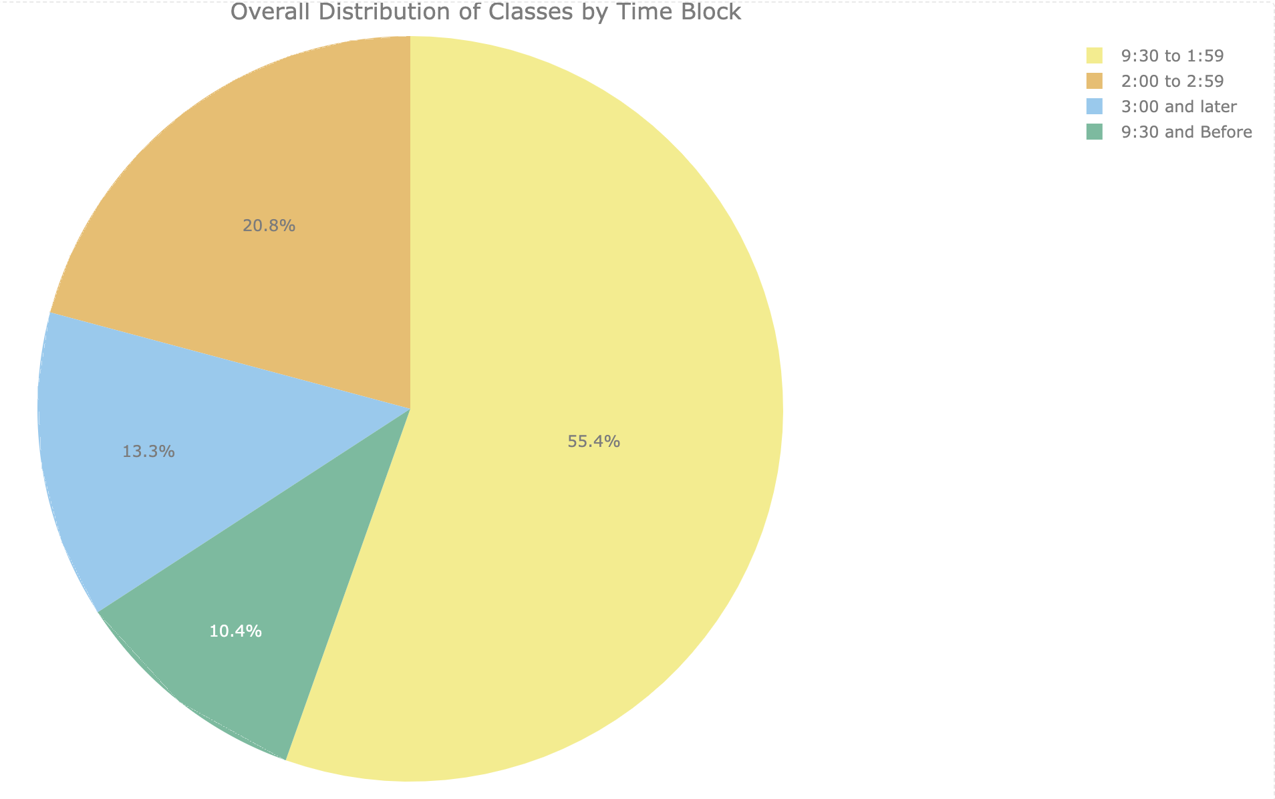
Visualization 1
The chart at left shows the general distribution of classes at Wake Forest broken up into designated time blocks... “Pre-peak” - Before 9:30am, “Peak” - 9:30 am-1:59 pm, “Peakest Peak” - 2:00-2:59 pm, and “Post-Peak” - after 3:00 pm. Here, we see that the bulk of classes, some 76.2% to be exact, occur between 9:30 and 2:59 on a given day.

Slide 5
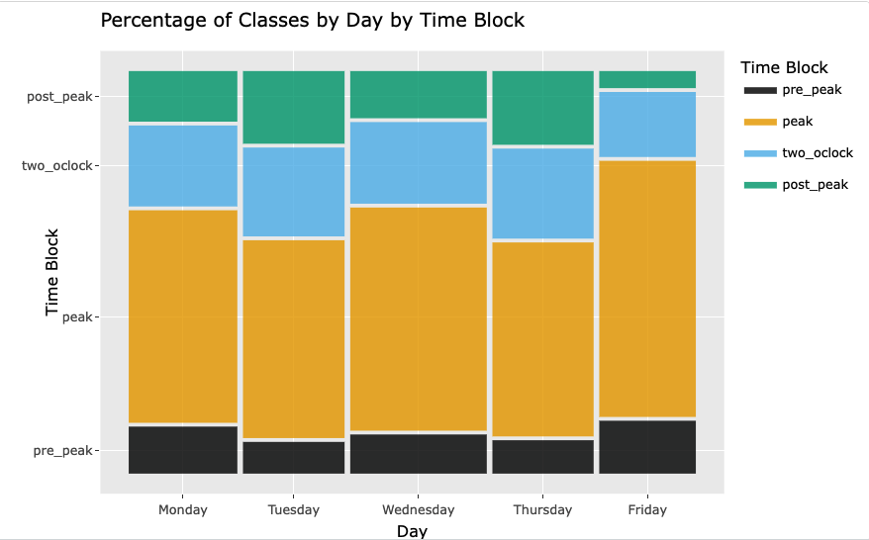
Visualization 2
Using the same “peak” designations, this plot shows the percentage of each classes taking place on each specific day. Similar to the general percentages, the vast majority of classes take place between 9:30 and 2:59.

Slide 6
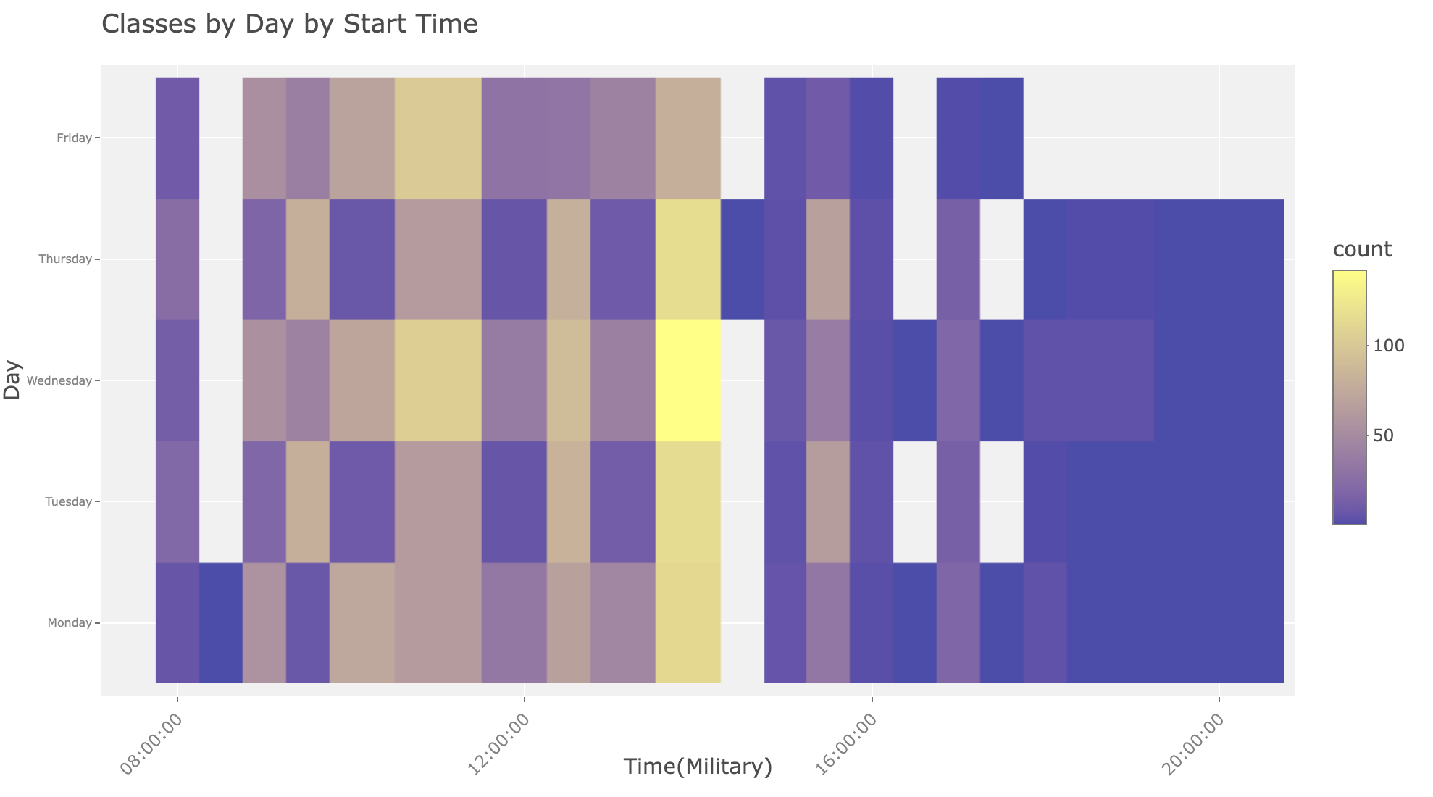
Visualization 3
For a better look at each day, this plot goes across the day, starting at 8:00 am, and examines the amount of classes starting at each hour. The more intense yellow suggests more classes(and therefore more demand for classroom space) while the deeper purple suggests fewer.

Slide 7
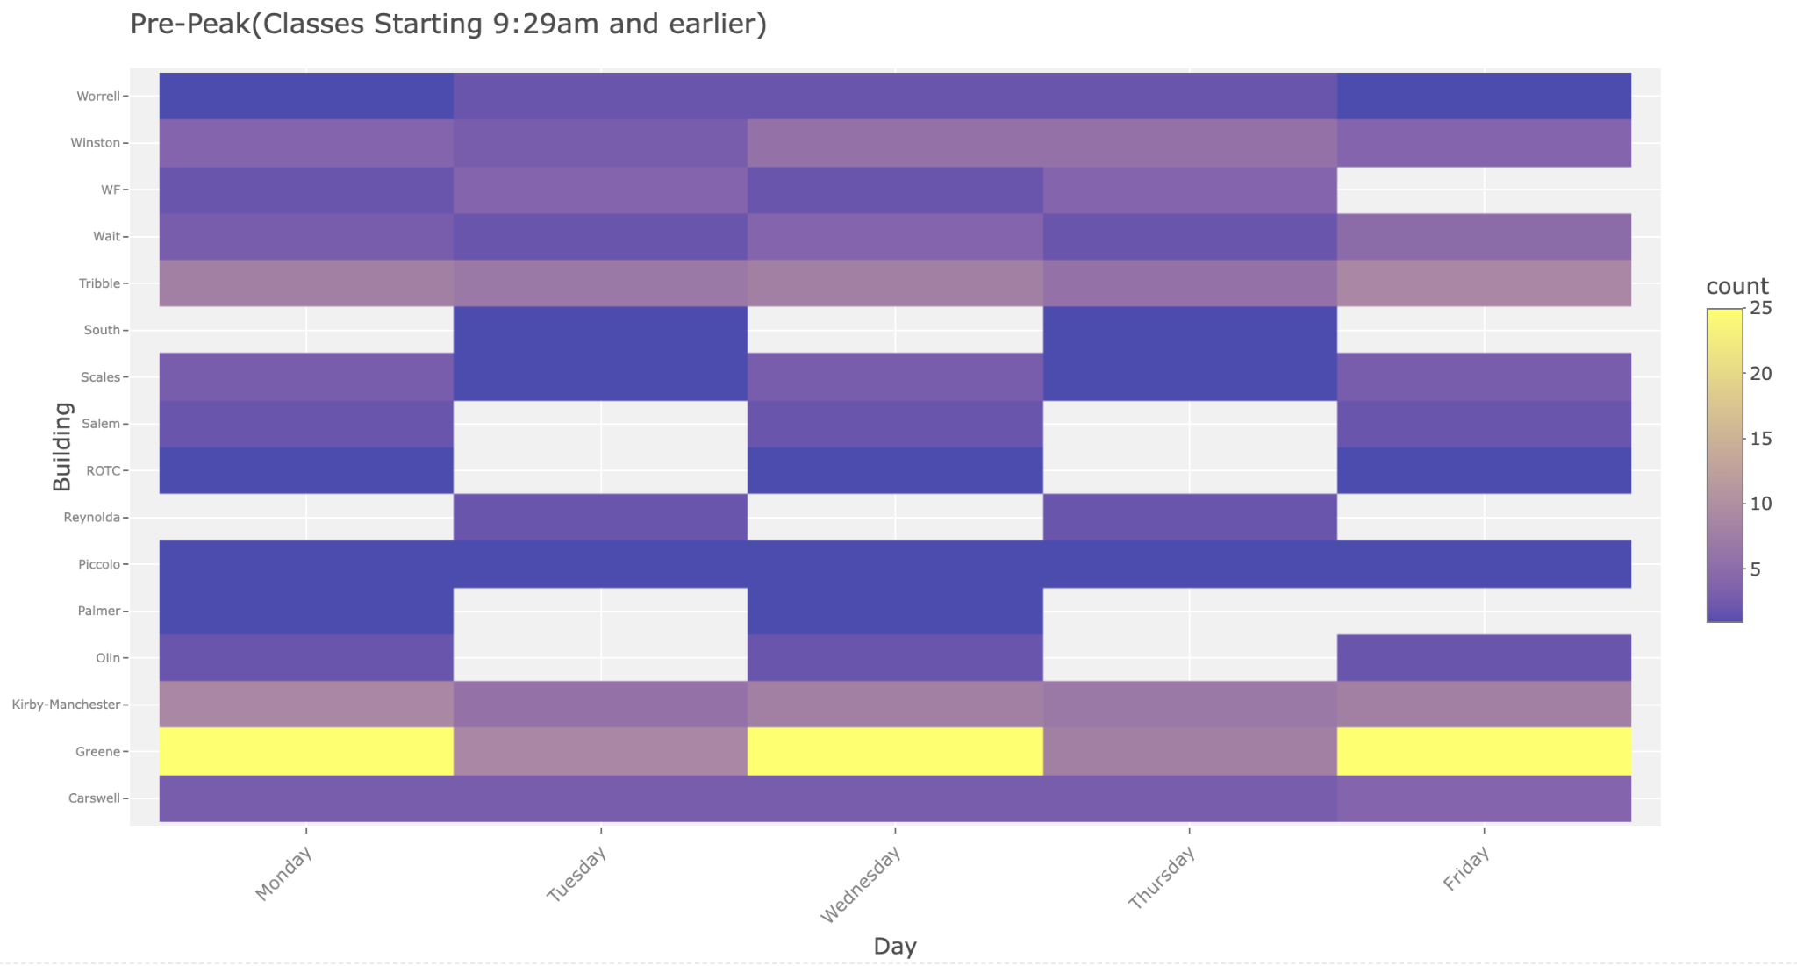
Visualization 4
Following with the “peak” designations, this plot(and the following three) show the density of classes across each day of the week for each academic building on campus. This specific plot focuses on the “Pre-Peak” slot: classes beginning before 9:30 am.

Slide 8
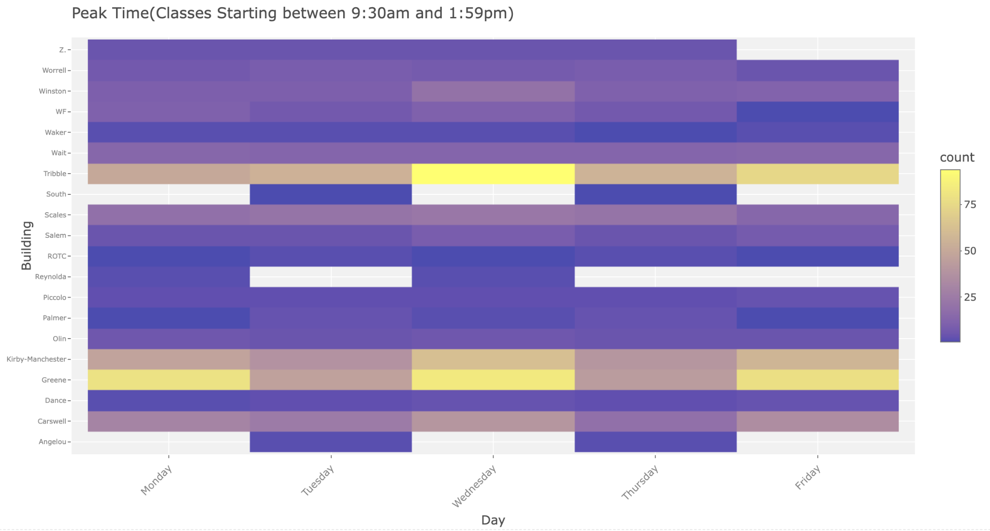
Visualization 5
For the “Peak” slot: 9:30 am to 1:59 pm

Slide 9
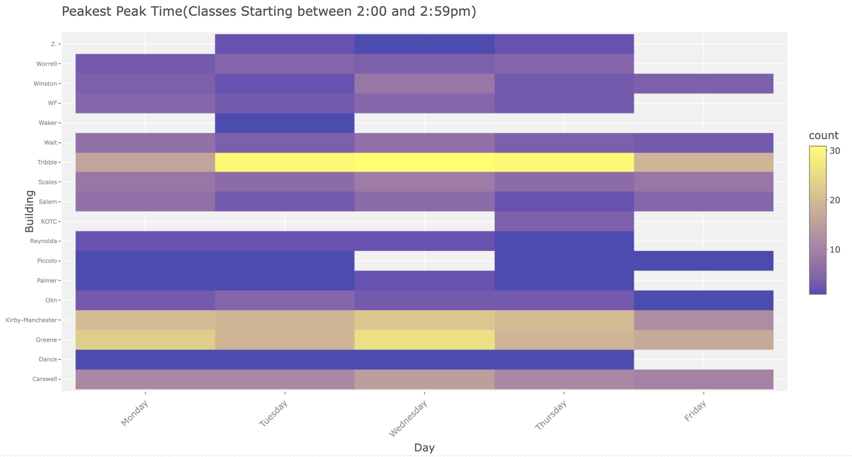
Visualization 6
Continuing with the “Peakest Peak” block: 2:00 to 2:59 pm

Slide 10
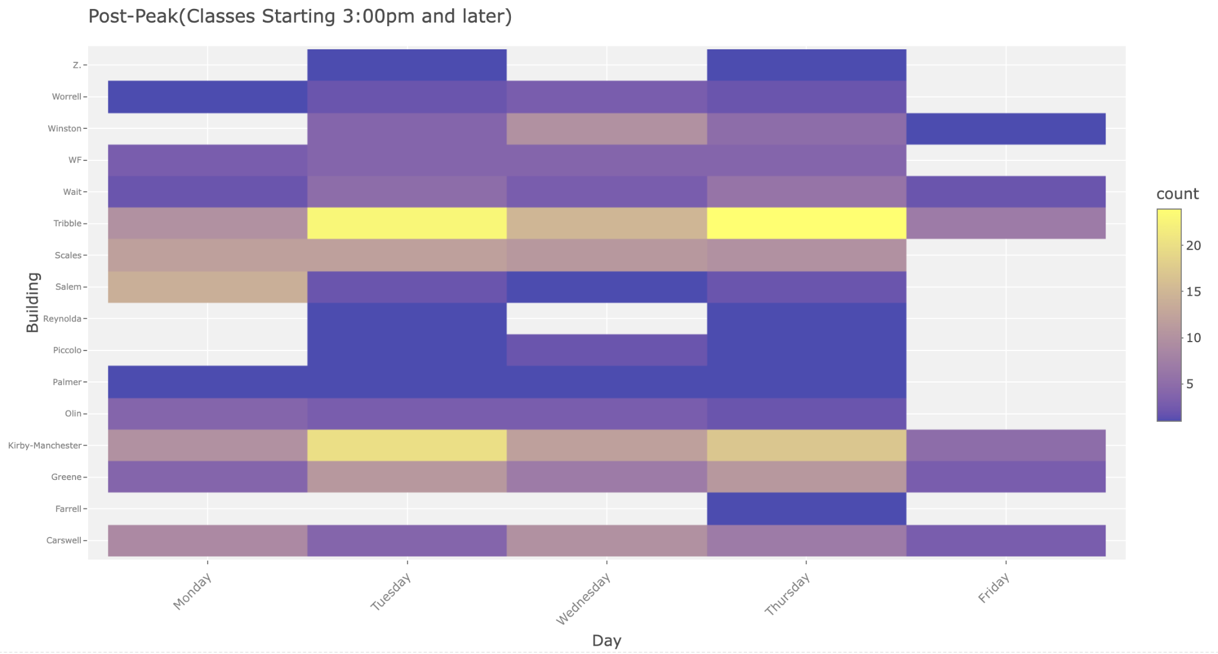
Visualization 7
Finally, the “Post-Peak” block: 3:00 pm and later

Slide 11
General-Use Classroom Space
How much demand is there for general-use classrooms on campus?

Slide 12
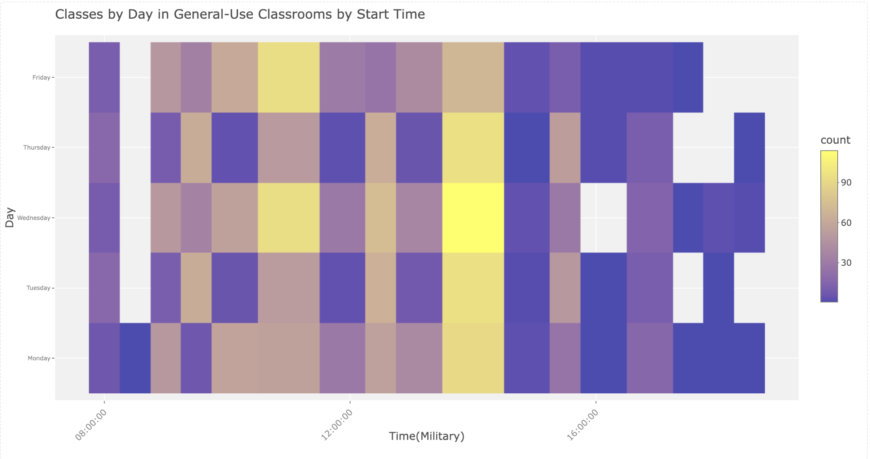
Visualization 1
Similar to the general visualization, the more intense yellow indicates more classes(and therefore more demand for classroom space) and the deeper purple represents fewer classes. This plot only shows results for classes in general-use rooms.

Slide 13
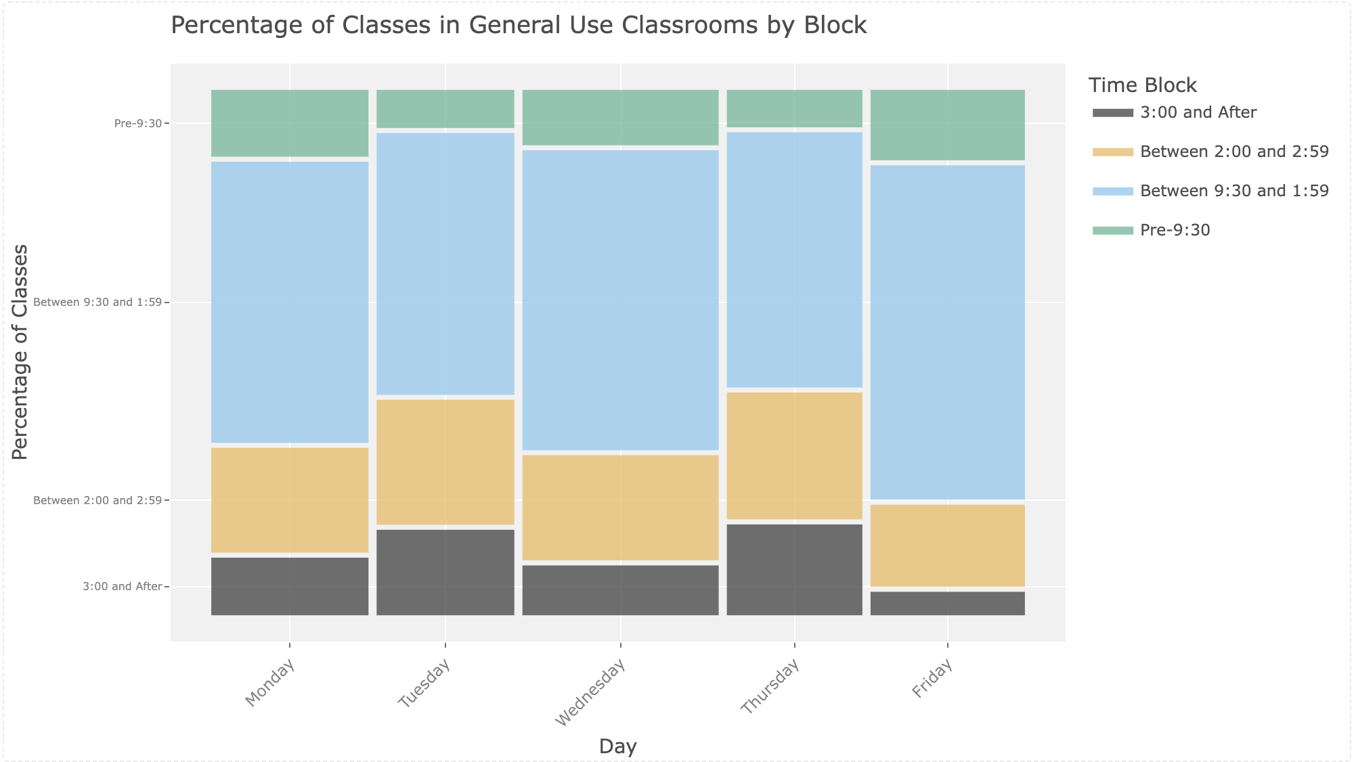
Visualization 2
This plot shows the percentage of classes taking place in general-use classrooms for each day in the week. The larger bars indicate higher percentages. There is an ever bigger percentage of classes between 9:30 am and 1:59 pm.

Slide 14
Half Semester Classes
Similar Visualizations - but taking first and second half of semester classes into account

Slide 15
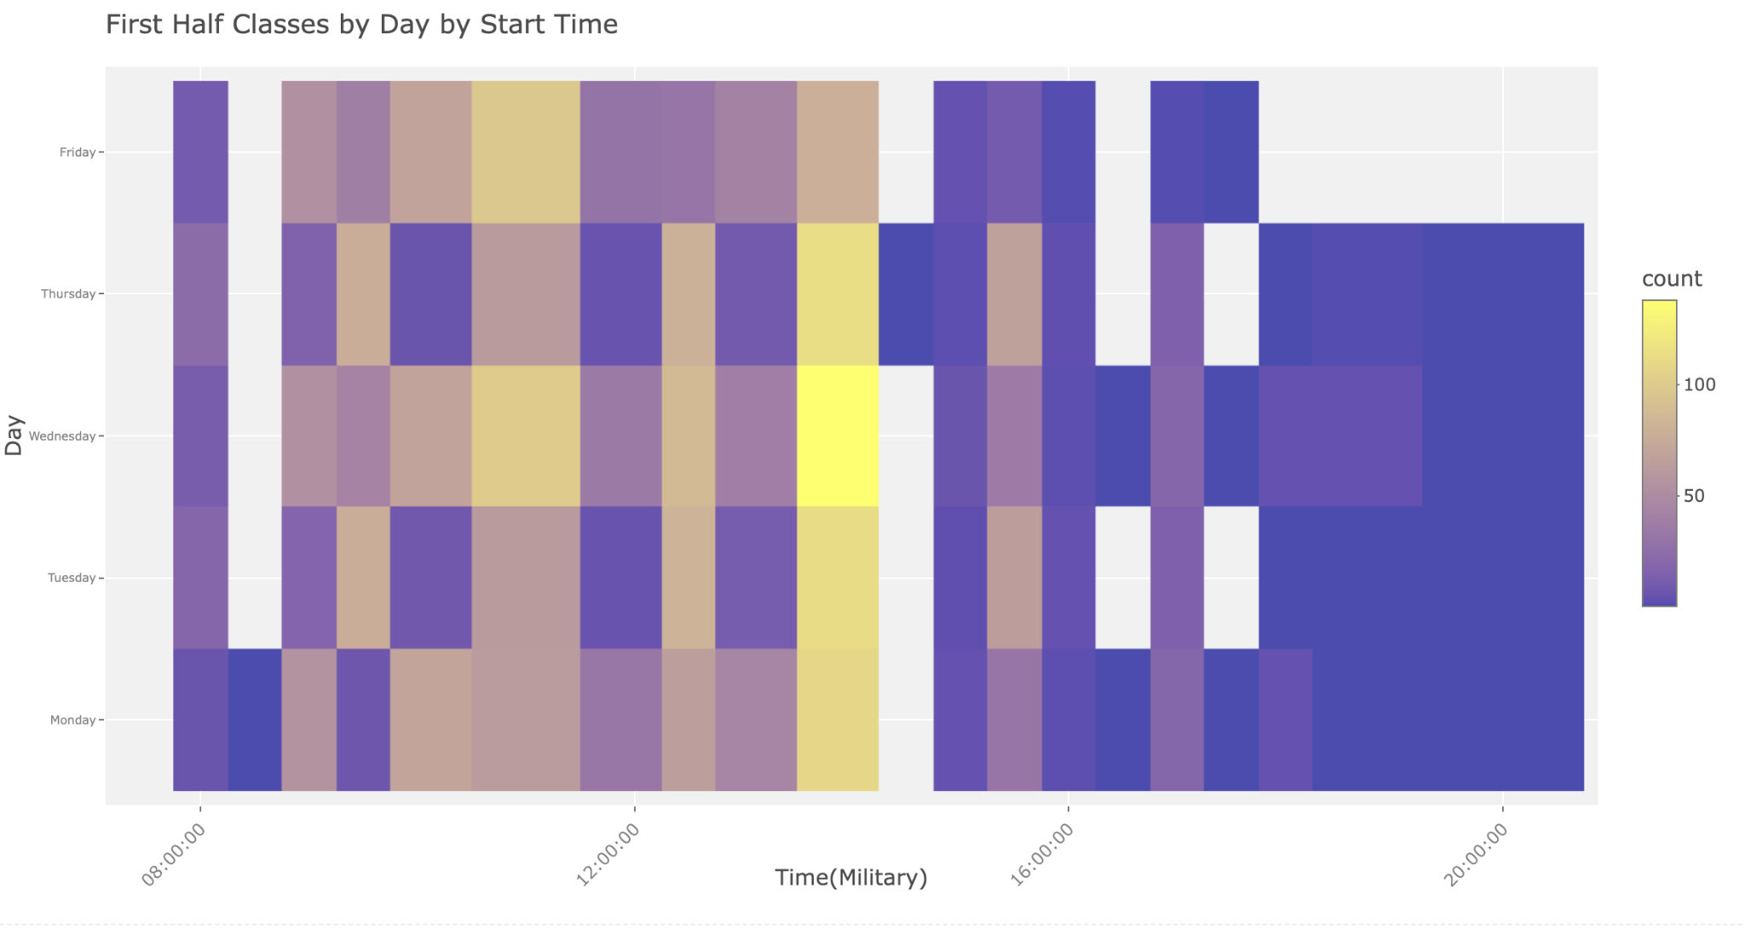
Visualization 1
This plot shows the percentage of classes taking place in general-use classrooms for each day in the week. The larger bars indicate higher percentages. There is an ever bigger percentage of classes between 9:30 am and 1:59 pm.

Slide 16

Visualization 2
This plot shows the percentage of 2nd half semester classes taking place in general-use classrooms for each day in the week. The larger bars indicate higher percentages. There is an even bigger percentage of classes between 9:30 am and 1:59 pm.
As you can see, there is barely any difference between the heatmaps in this slide and the previous one (in terms of class timing)

Slide 17
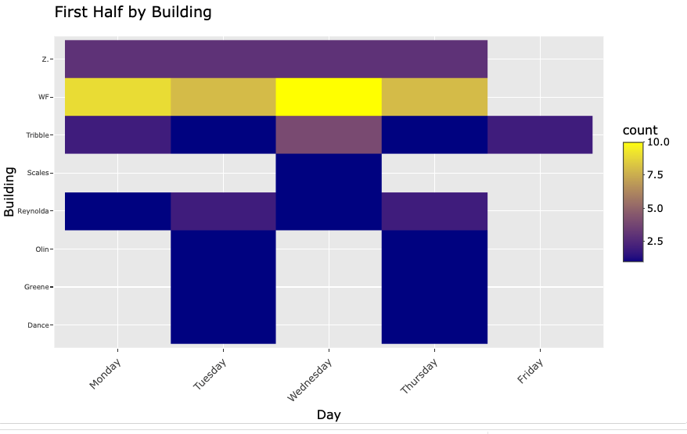
Visualization 3
This plot shows the total half-semester classes each day in the week by building. The more intense colors represent higher counts.

Slide 18
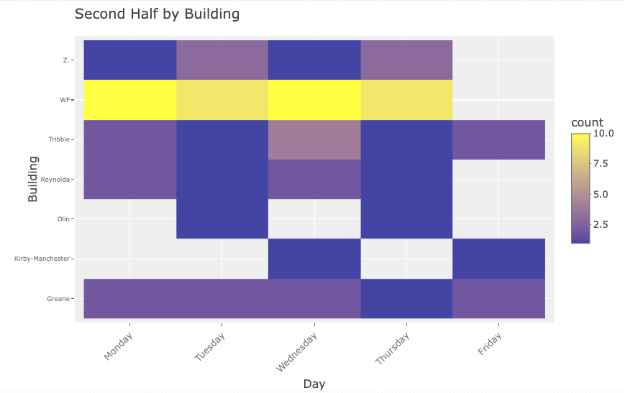
Visualization 4
The same as the previous, but for the second half.

Slide 19
Wake Downtown
Applying the same steps and visualizations, but to a separate dataset that only includes the Wake Forest downtown schedule.

Slide 20
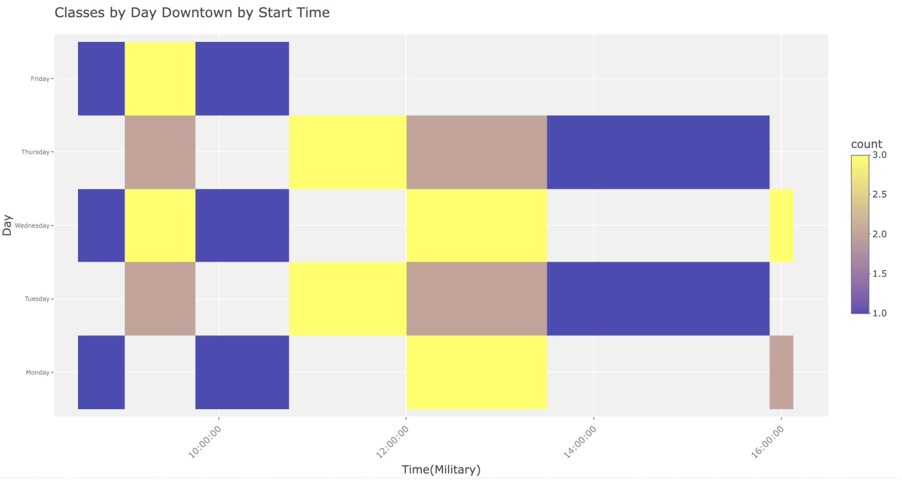
Visualization 1 - Wake Downtown
Similar to the general visualization, the more intense yellow indicates more classes(and therefore more demand for classroom space) and the deeper purple represents fewer classes. This plot only shows results across the times of day for each day at Wake Downtown.

Slide 21
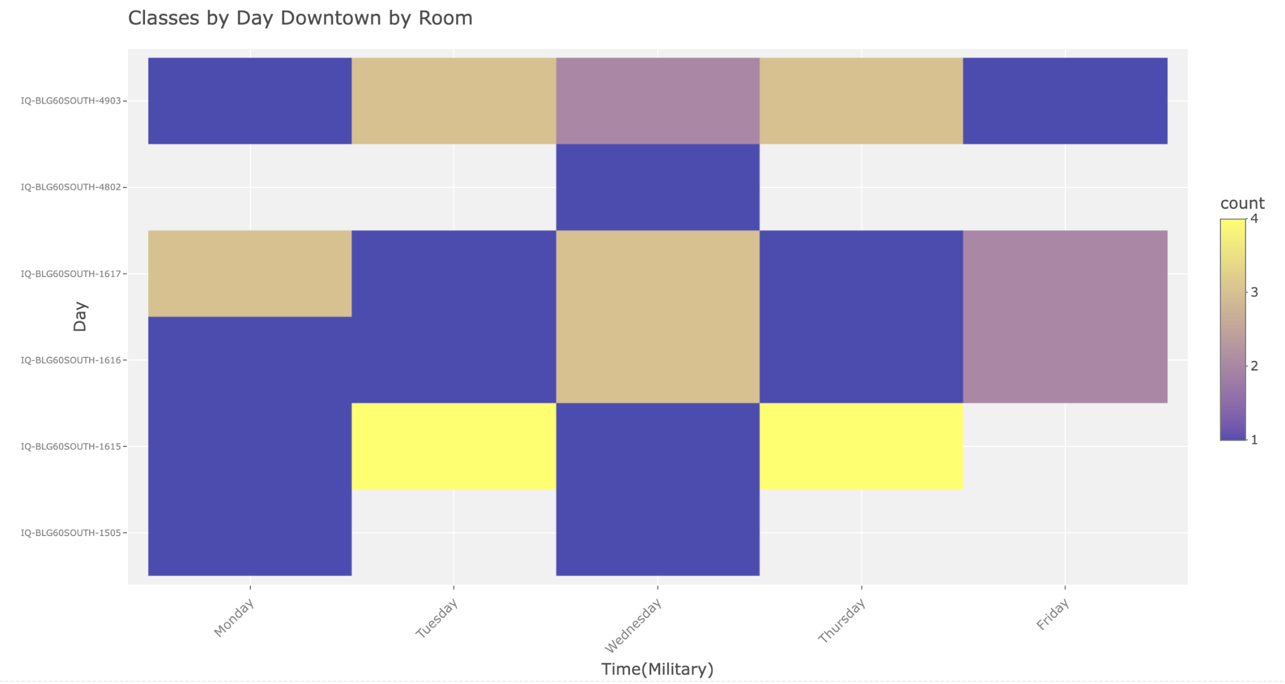
Visualization 2 - Wake Downtown
Similar to the general visualization, the more intense yellow indicates more classes(and therefore more demand for classroom space) and the deeper purple represents fewer classes. This plot only shows results for classes in Wake Downtown spaces.

Slide 22
Thank
you!

